Slide 1


WDMM 3314 Web and Multimedia Engineering SDEV 2301 Principles of Software Engineering Chapter 1 Introduction Part 1 Professional software development
Dr. Nour Almadhoun Alserr
Lecture 2-4
Week 1&2
Notes:
Overcome Challenges

Slide 2
Objectives
Understand what software engineering is and why it is important.
Understand that the development of different types of software system may require different software engineering techniques.

Slide 3
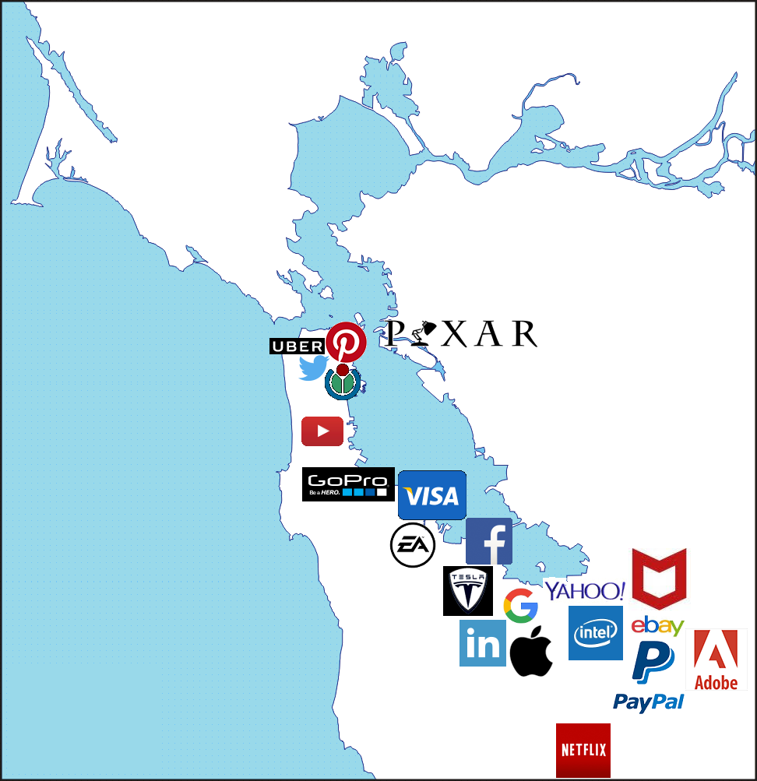
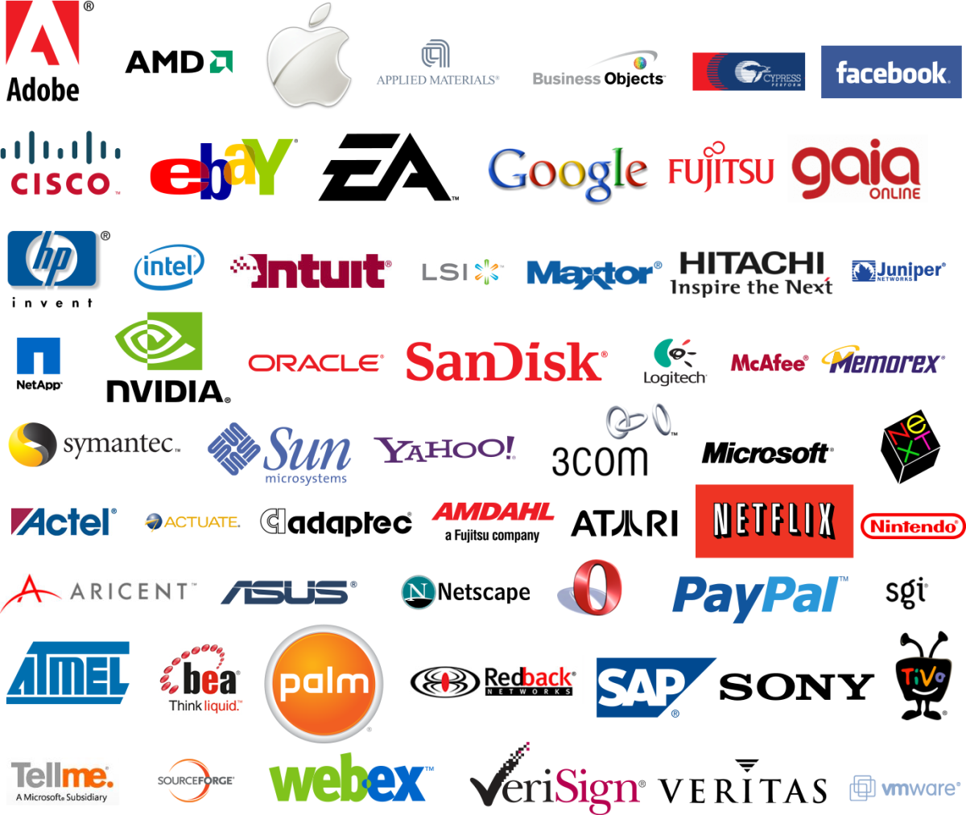
Software Engineering
The economies of ALL developed nations are dependent on software.
More and more systems are software controlled.
Silicon Valley
https://mapsontheweb.zoom-maps.com/post/170276505313/most-important-high-tech-companies-in-san

Slide 4

Software Engineering
Expenditure on software represents a significant fraction of Gross national product (GNP) GNP in all developed countries.
Worldwide IT spending is projected to total $4.6 trillion in 2023.
Notes:
Expenditure مصروفات
Worldwide IT spending is projected to total $4.6 trillion in 2023

Slide 5
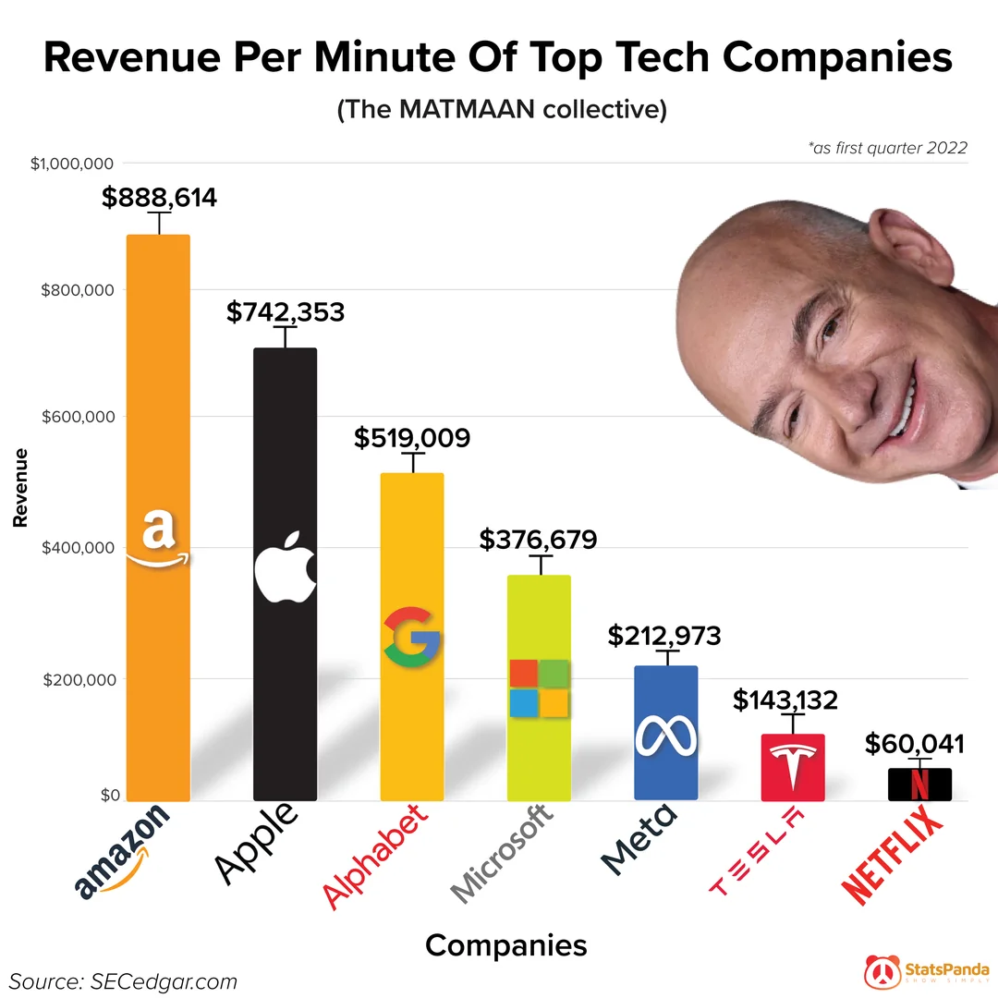
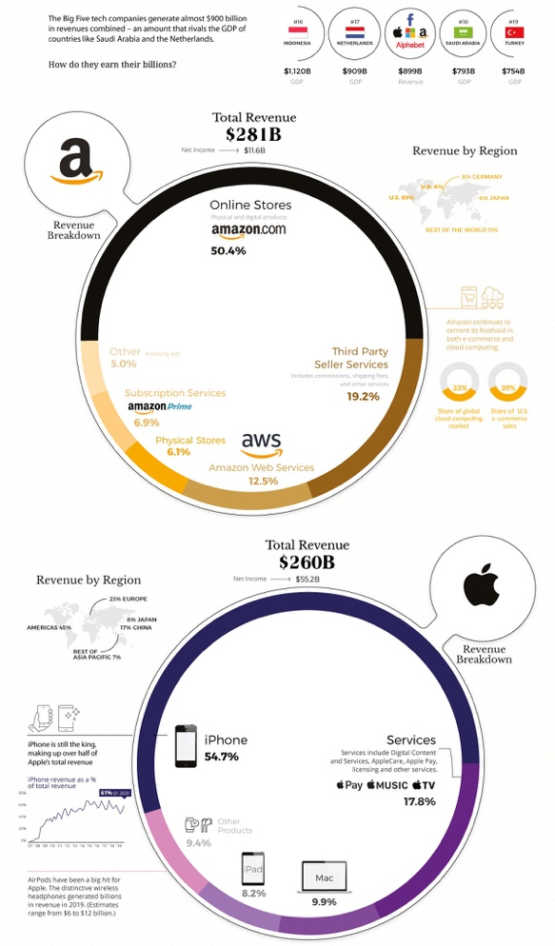
Software Engineering
https://www.reddit.com/r/dataisbeautiful/comments/vu8vvz/oc_revenue_profit_per_minute_of_top_tech_companies/
https://www.visualcapitalist.com/how-tech-giants-make-billions/
Notes:
As of 2021, the global tech industry is worth roughly $5.2 trillion
FaceBook: $71B

Slide 6
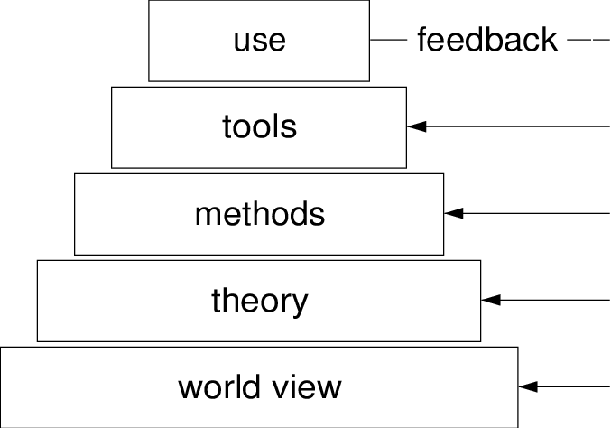
Software Engineering
Software engineering is concerned with theories, methods and tools for professional software development.
SW Engineering
Notes:
Expenditure مصروفات
Worldwide IT spending is projected to total $4.6 trillion in 2023

Slide 7
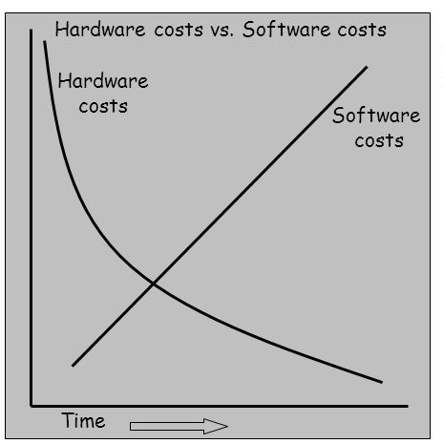
Software Cost
Software costs often dominate computer system costs. The costs of software on a PC are often greater than the hardware cost.
Software engineering is concerned with cost-effective software development.

Slide 8
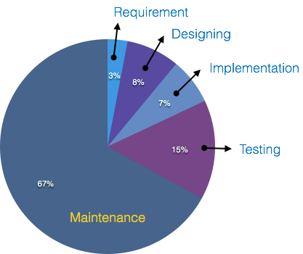
Software Cost
Software costs more to maintain than it does to develop. For systems with a long life, maintenance costs may be several times development costs.
Software engineering is concerned with cost-effective software development.
https://sceweb.sce.uhcl.edu/helm/WEBPAGES-SoftwareEngineering/myfiles/TableContents/Module-13/software_maintenance_overview.html
Notes:
The standard age of any software is considered up to 10 to 15 years.
Older softwares, which were meant to work on slow machines with less memory and storage capacity cannot keep themselves challenging against newly coming enhanced softwares on modern hardware.
As technology advances, it becomes costly to maintain old software.
Most maintenance engineers are newbie and use trial and error method to rectify problem.
Often, changes made can easily hurt the original structure of the software, making it hard for any subsequent changes.
Changes are often left undocumented which may cause more conflicts in future.

Slide 9
Software Failure
There are still many reports of software projects going wrong and of “software failures.”
Many of these so-called software failures are a consequence of two factors:
1- Increasing system complexity
Systems have to be built and delivered more quickly; larger, even more complex systems are required; and systems have to have new capabilities that were previously thought to be impossible..

Slide 10
Software Failure
There are still many reports of software projects going wrong and of “software failures.”
Many of these so-called software failures are a consequence of two factors:
2. Failure to use software engineering methods
Many development companies do not use software engineering methods in their everyday work. Consequently, their software is often more expensive and less reliable than it should be.

Slide 11
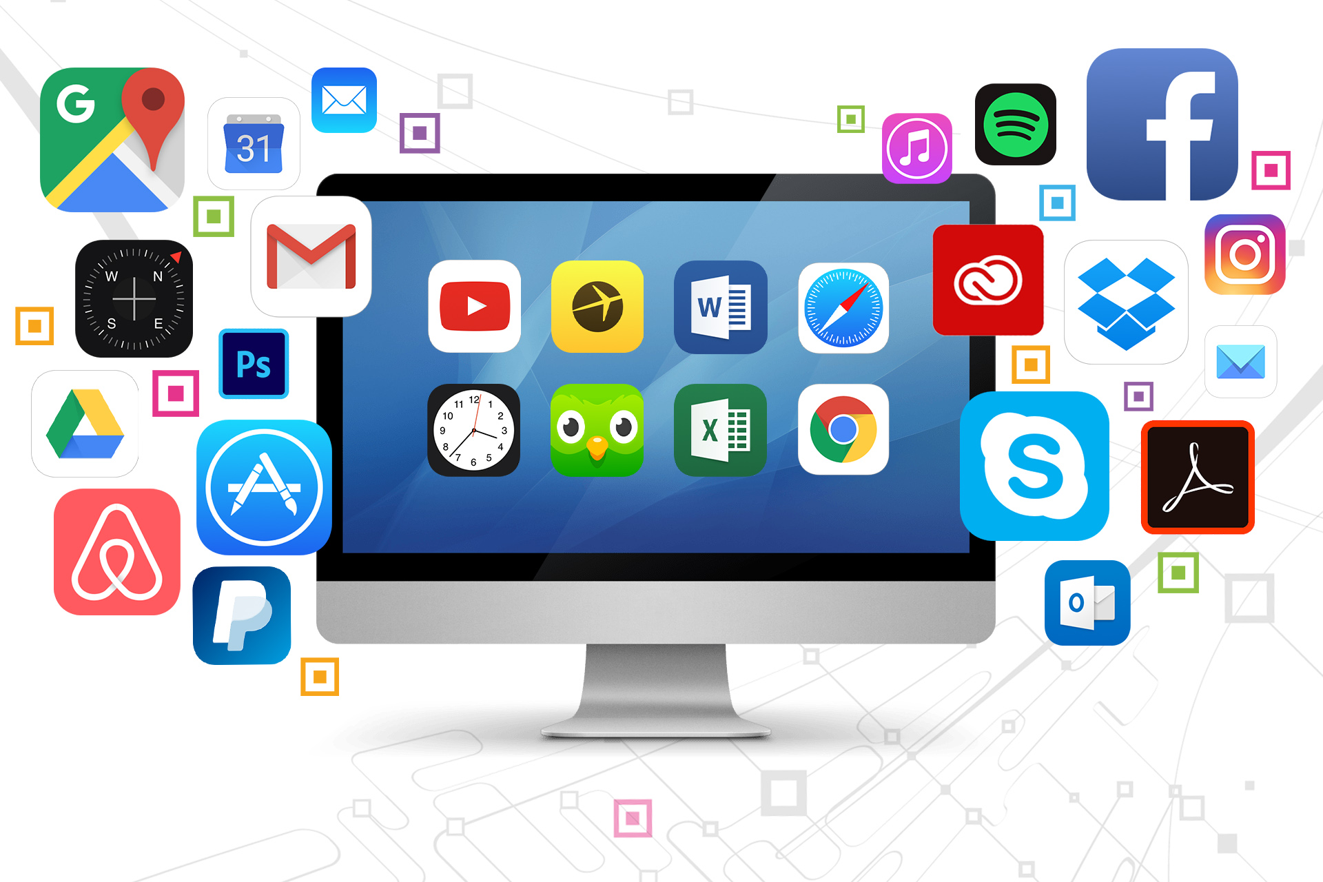
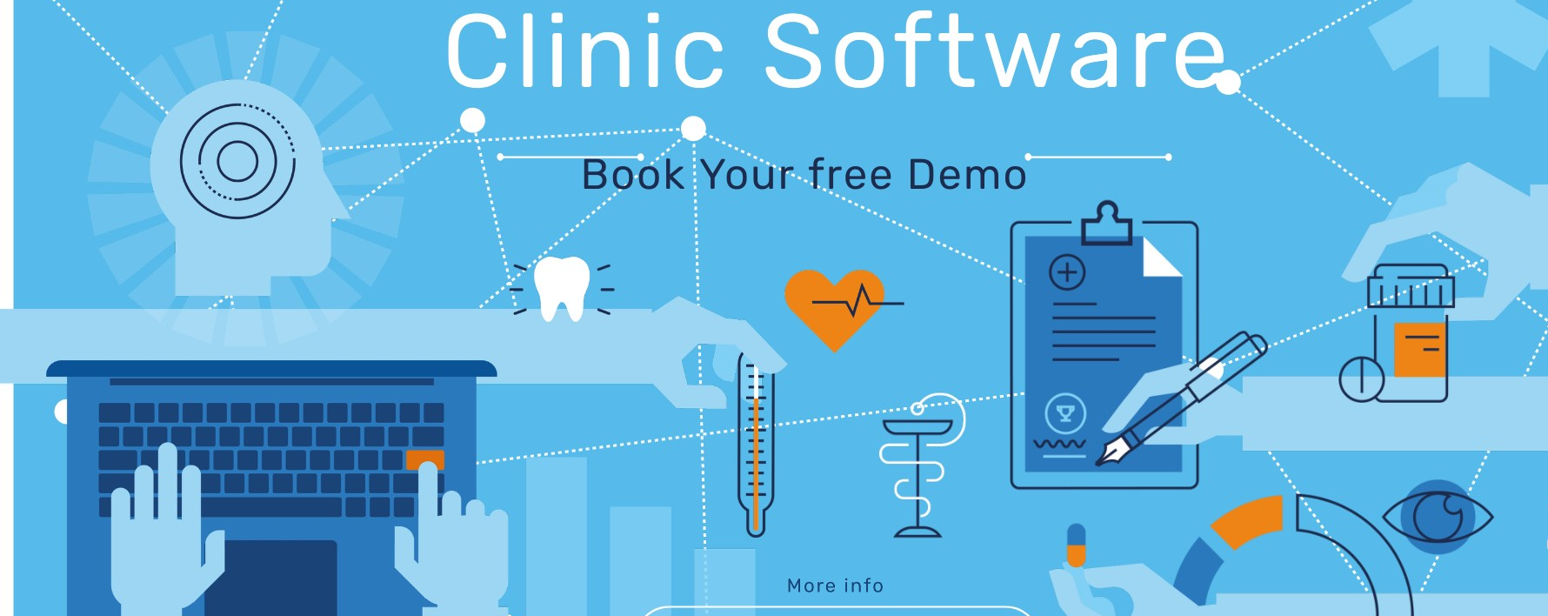
Frequently Asked Questions (FAQs)
What is software (SW)?
Computer programs and associated documentation.
Software products may be developed for a particular customer or may be developed for a general market.
1
Particular customer
General market
https://www.coderus.com/software-101-a-complete-guide-to-the-different-types-of-software/

Slide 12
Frequently Asked Questions (FAQs)
What are the attributes of good software?
2
3 Maintainable
2 Usable
1 Deliver the required functionality
(Efficient)
Attributes of
good software
4 Dependable and secure
Notes:
deliver the required functionality and performance to the user and should be maintainable, dependable
جدير بالثقه
and usable Efficient: high speed, high quality, low cost.

Slide 13
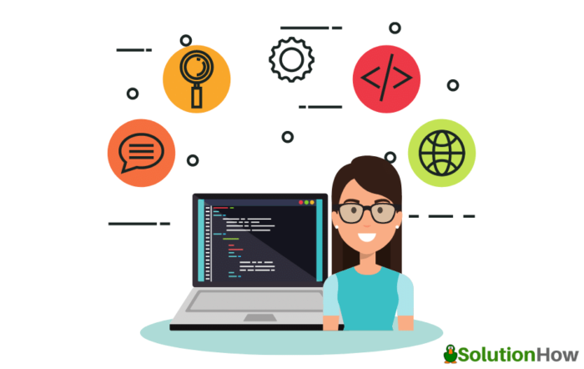


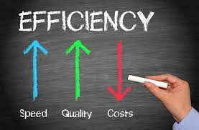
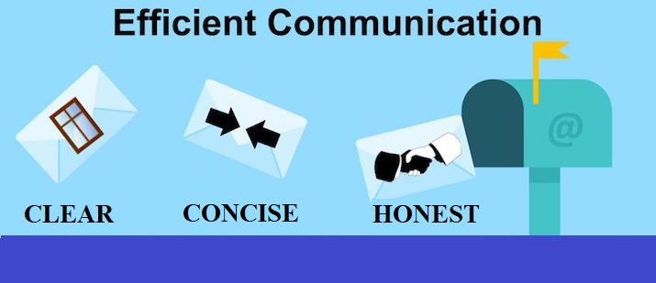
Frequently Asked Questions (FAQs)
3
What is software engineering?
Applying Engineering Principles to all aspects of software production.
13
Notes:
Engineering discipline> Using appropriate theories and methods to solve problems bearing in mind organizational and financial constraints.

Slide 14
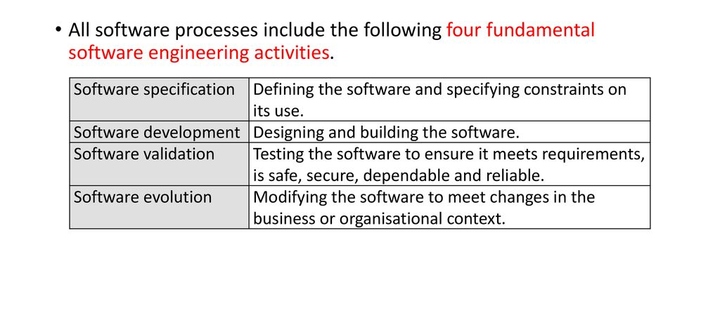
Frequently Asked Questions (FAQs)
4
What are the fundamental software engineering activities?
efficient, usable, maintainable, dependable and secure.
14
Notes:
Software specification, where customers and engineers define the software that is to be produced and the constraints on its operation.
Software development, where the software is designed and programmed.
Software validation, where the software is checked to ensure that it is what the customer requires.
Software evolution, where the software is modified to reflect changing customer and market requirements.
efficient, usable, maintainable, dependable, and secure.

Slide 15
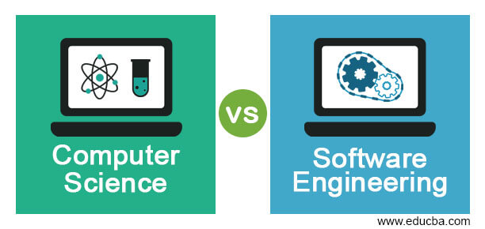
Frequently Asked Questions (FAQs)
5
What is the difference between software engineering and computer science?
Theory
Fundamentals
Practicalities of :
Developing &
Delivering useful software
15
Notes:
Computer science focuses on theory and fundamentals الأساسيات
; software engineering is concerned with the practicalities of developing and delivering useful software.

Slide 16
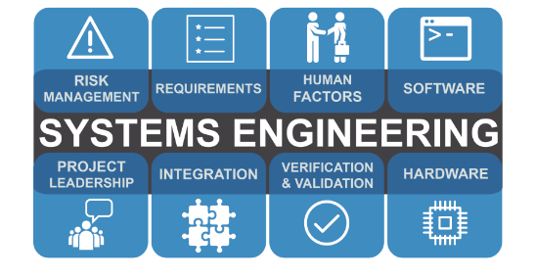
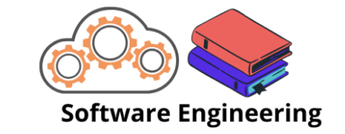
Frequently Asked Questions (FAQs)
6
What is the difference between software engineering and system engineering?
System engineering is concerned with all aspects of computer-based systems development including hardware, software and process engineering.
Software engineering is part of this more general.
16

Slide 17




Frequently Asked Questions (FAQs)
7
What are the key challenges facing software engineering?
Developing trustworthy software
Demands
for reduced delivery
times
Increasing diversity
17
Notes:
Increasing diversity means embracing and advocating differences from person to person within the organization – ethnicity, gender, age, origin, disability, religion, etc.
الْمُؤْمِنُ الَّذِي يُخَالِطُ النَّاسُ، وَيَصْبِرُ عَلَى أَذَاهُمْ؛ أَفْضَلُ مِنَ ‌الْمُؤْمِنَ الَّذِي لَا ‌يُخَالِطُ النَّاسَ، وَلَا ‌يَصْبِرُ ‌عَلَى أَذَاهُمْ
SW diversity: There are many different types of software system and there is no universal set of software techniques that is applicable to all of these.
Software Trustworthiness has 5 facets. They are Safety, Reliability, Availability, Resilience and Security

Slide 18
Frequently Asked Questions (FAQs)
8
What are the costs of software engineering?
Roughly 60% of software costs are development costs.
Second most are the testing costs (40%).
For custom software, evolution costs often exceed development costs.
Developing trustworthy software
Demands
for reduced delivery
times
Increasing diversity
18
Notes:
Software Evolution is a term which refers to the process of developing software initially, then timely updating it for various reasons,

Slide 19
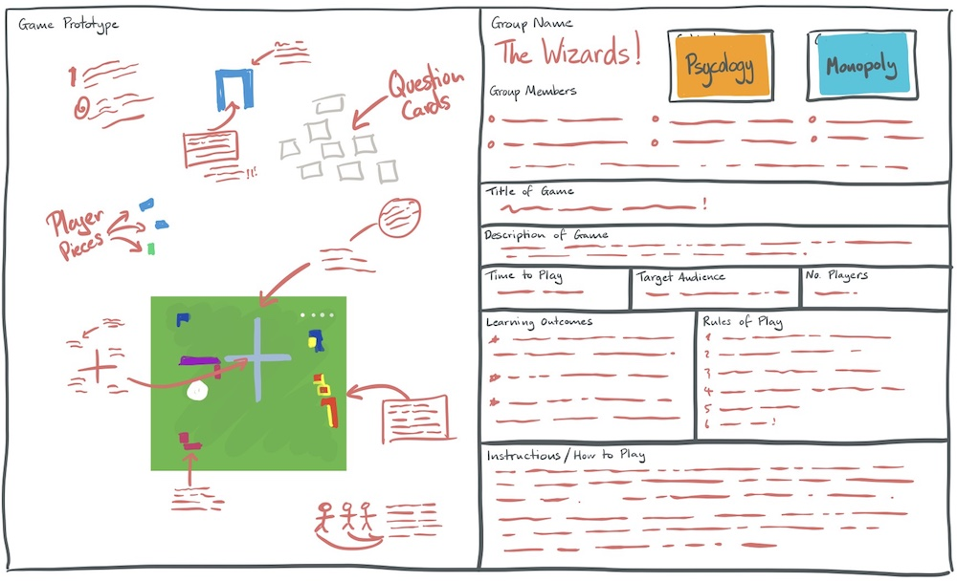
Frequently Asked Questions (FAQs)
9
What are the best software engineering techniques and methods?
Different techniques are appropriate for different types of system.
Games
Developing trustworthy software
Demands
for reduced delivery
times
Increasing diversity
Prototypes
19
Notes:
While all software projects have to be professionally managed and developed, different techniques are appropriate for different types of system. For example, games should always be developed using a series of prototypes whereas safety critical control systems require a complete and analyzable specification to be developed. You can’t, therefore, say that one method is better than another.

Slide 20

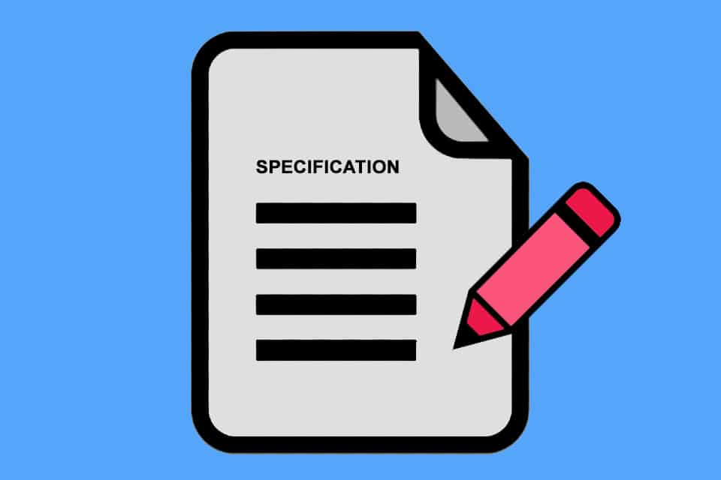

Frequently Asked Questions (FAQs)
9
What are the best software engineering techniques and methods?
Different techniques are appropriate for different types of system.
Safety critical control systems
Developing trustworthy software
Demands
for reduced delivery
times
Complete and
analyzable
specification
Increasing diversity
https://content.intland.com/blog/safety-engineering/achieving-functional-safety-in-safety-critical-embedded-systems-2
20
Notes:
safety critical control systems > A computer, electronic or electromechanical system whose failure may cause injury or death to human beings
Analyzable specification
مواصفات قابلة للتحليل

Slide 21
Frequently Asked Questions (FAQs)
9
What are the best software engineering techniques and methods?
No universal set of software techniques that is applicable to all of different types of software system.
The software engineering methods and tools used depend on the type of application being developed, the requirements of the customer and the background of the development team.
You can NOT say that one method is better than another.
21

Slide 22
Frequently Asked Questions (FAQs)
10
What differences has the web made to software engineering?
The availability of software services.
The possibility of developing highly distributed service-based systems.
Web-based systems development has led to important advances in programming languages and software reuse.
22

Slide 23
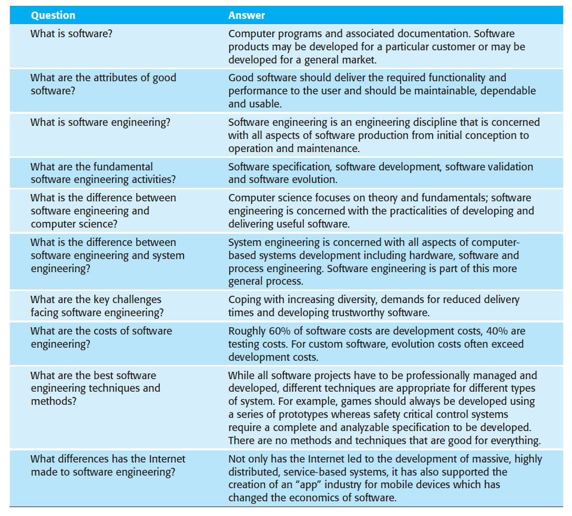
FAQs

Slide 24
Software Products
 | Generic products | Customized products
Customers | Marketed and sold to any customer who wishes to buy them (stand-alone systems). | a specific customer to meet their own needs (bespoke).
Example | Apps for mobile devices. Software for PCs (e.g., databases, drawing packages, and project management tools). | Control systems for electronic devices. Particular business process. Air traffic control systems.
Specification and changes | Owned by the software developer | Owned by the customer.
24
Notes:
However, the distinction between these system product types is becoming increasingly blurred. More and more systems are now being built with a generic product as a base, which is then adapted to suit the requirements of a customer.

Slide 25

RECALL: FAQs
3
What is software engineering?
Applying Engineering Principles to all aspects of software production.
25
Notes:
Engineering discipline> Using appropriate theories and methods to solve problems bearing in mind organizational and financial constraints.

Slide 26
Software Engineering
Engineering Principles:
Engineers make things work.
They apply theories, methods, and tools where these are appropriate.
Try to discover solutions to problems (within organizational and financial constraints).
All aspects of software production: Not only technical processes of software development, but also project management and the development of tools, methods, and theories.
Notes:
قيودconstraints

Slide 27
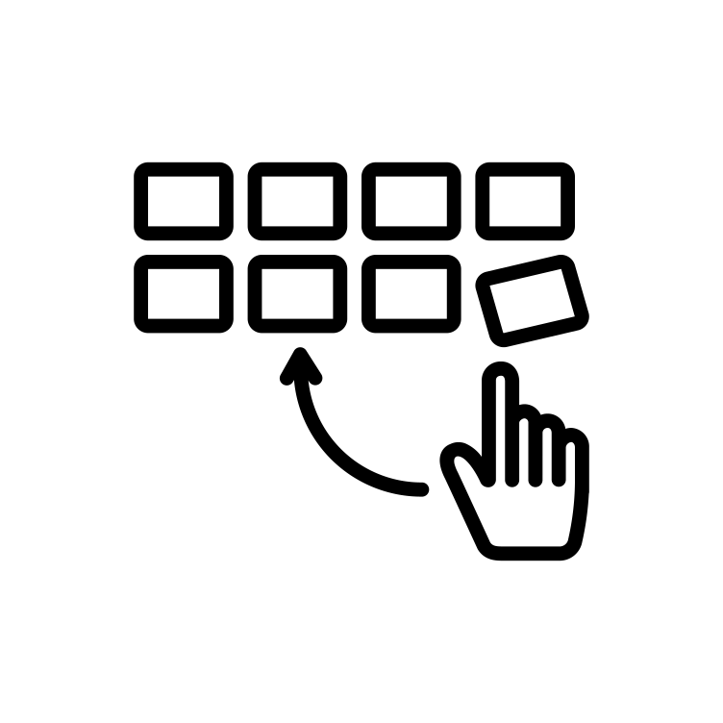

Software Engineering
Adopt a …
Systematic (process = 4 activities) & Organized
Approach
https://thenounproject.com/icon/systematic-3859137/
Notes:
منهجي(نظام) ومنظم
Activities: 1. Software specification, 2. Software development, 3. Software validation, 4. Software evolution.

Slide 28
RECALL: FAQs
4
What are the fundamental software engineering activities?
efficient, usable, maintainable, dependable and secure.
28
Notes:
Software specification, where customers and engineers define the software that is to be produced and the constraints on its operation.
Software development, where the software is designed and programmed.
Software validation, where the software is checked to ensure that it is what the customer requires.
Software evolution, where the software is modified to reflect changing customer and market requirements.
efficient, usable, maintainable, dependable, and secure.

Slide 29
Importance of Software Engineering
Individuals and society rely on advanced software systems. We need to be able to produce reliable and trustworthy systems economically and quickly.
Cheaper, in the long run, to use software engineering methods. Failure to use software engineering method leads to
higher costs for testing,
quality assurance, and
long-term maintenance.
Notes:
مصداقية reliable
Reliability is the degree of consistency of a measure. A test will be reliable when it gives the same repeated result under the same conditions.

Slide 30
RECALL: Software Failure
There are still many reports of software projects going wrong and of “software failures.”
Many of these so-called software failures are a consequence of two factors:
1- Increasing system complexity
2. Failure to use software engineering methods
Notes:
استدعاء

Slide 31
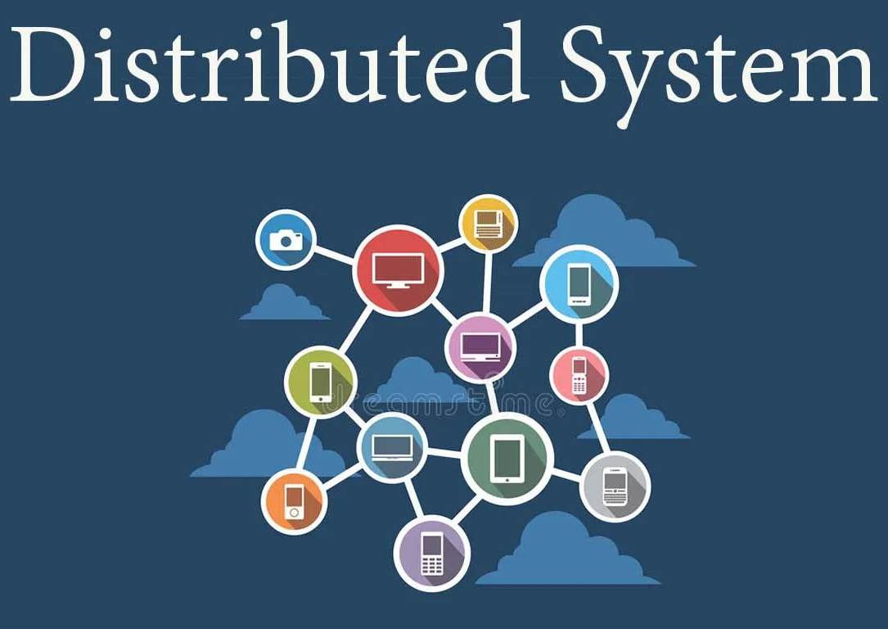
General Issues That Affect SW
1. Heterogeneity
Increasingly, systems are required to operate as distributed systems across networks that include different types of computer and mobile devices.
2. Business and social change
Business and society are changing incredibly quickly as emerging economies develop and new technologies become available. They need to be able to change their existing software and to rapidly develop new software.
https://pragyasapkota.medium.com/distributed-system-the-definition-f4264046808e
Notes:
Heterogeneity: the quality or state of being diverse in character or content. عدم التجانس

Slide 32

General Issues That Affect SW
3. Security and trust
It is essential that we can trust that software. This is especially true for remote software systems accessed through the web. We have to make sure that malicious users cannot successfully attack our software .
https://www.flaticon.com/free-icon/cyber-attack_3205458

Slide 33
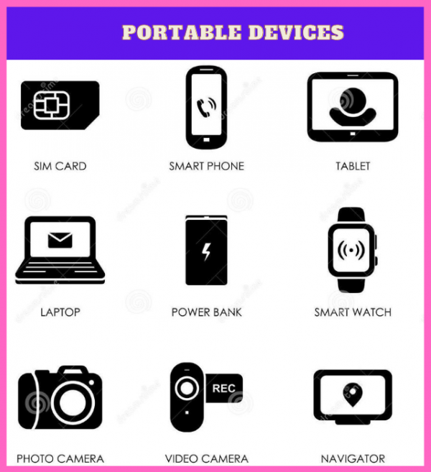
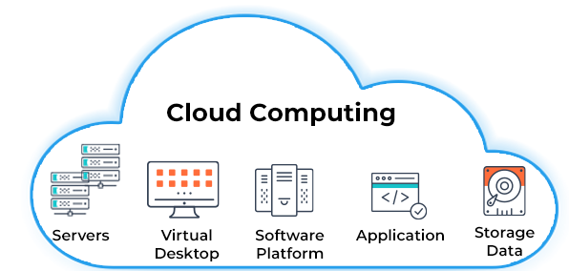
General Issues That Affect SW
4. Scale
Software has to be developed across a very wide range of scales, from very small embedded systems in portable or wearable devices through to Internet-scale, cloud-based systems that serve a global community.
https://www.ssla.co.uk/portable-devices/
https://www.spiceworks.com/tech/cloud/articles/what-is-cloud-computing/
Notes:
To address these challenges, we will need new tools and techniques as well as innovative ways of combining and using existing software engineering methods.

Slide 34
RECALL: FAQs
9
What are the best software engineering techniques and methods?
Diversity: No universal set of software techniques that is applicable to all of different types of software system.
The software engineering methods and tools used depend on the type of application being developed, the requirements of the customer and the background of the development team.
You can NOT say that one method is better than another.
34

Slide 35
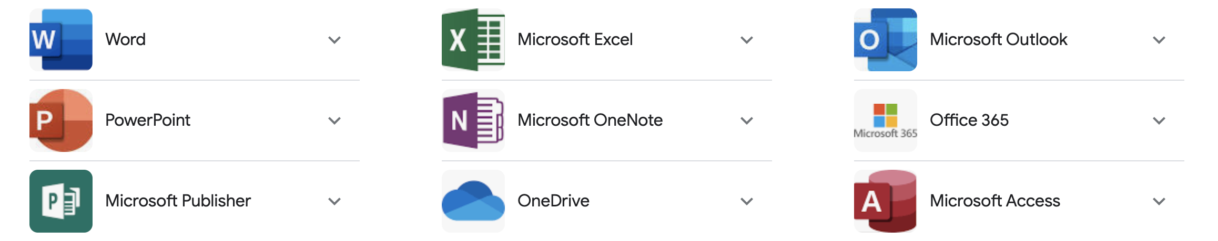
Application Types (1/8)
Stand-alone applications
These are application systems that run on a personal computer (PC) or apps run on mobile devices. They include all necessary functionality (no network connection is needed).
Examples: office applications, and travel apps.

Slide 36
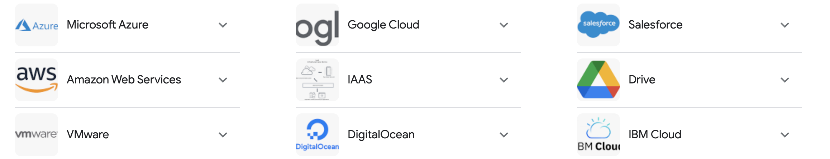
Application Types (2/8)
Interactive transaction-based applications
Apps that execute on a remote computer and are accessed by users from their own PCs, phones, or tablets.
Examples: web apps (e-commerce), business system, and cloud-based services.

Slide 37
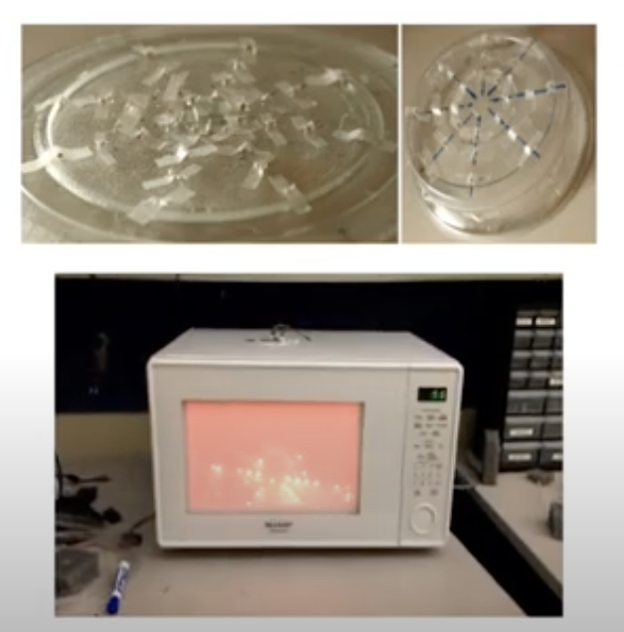
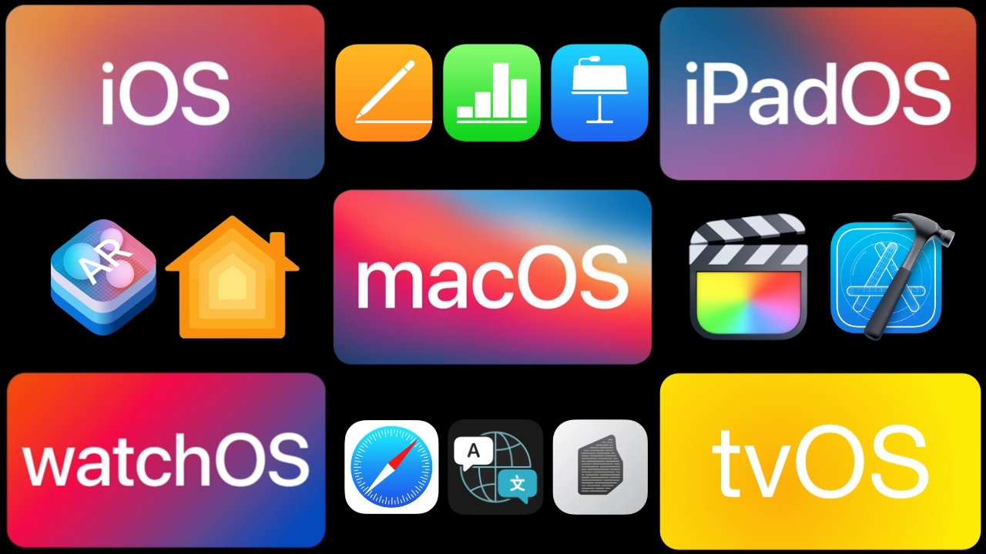
Application Types (3/8)
Embedded control systems (widely used)
These are software control systems that control and manage hardware devices.
Examples: software in a phone, and software in a microwave oven to control the cooking process.
https://appleinsider.com/inside/apple-software
https://www.youtube.com/watch?app=desktop&v=nB6XbREVvXk

Slide 38

Application Types (4/8)
Batch processing systems
Designed to process data in large batches. They process large numbers of individual inputs to create corresponding outputs.
Examples: periodic billing systems, such as phone billing systems, and salary payment systems.
https://www.vcallglobal.com/blog/2015/10/telecom-billing-systems-an-overview-benefits-and-future-trends/
Notes:
حزمة

Slide 39
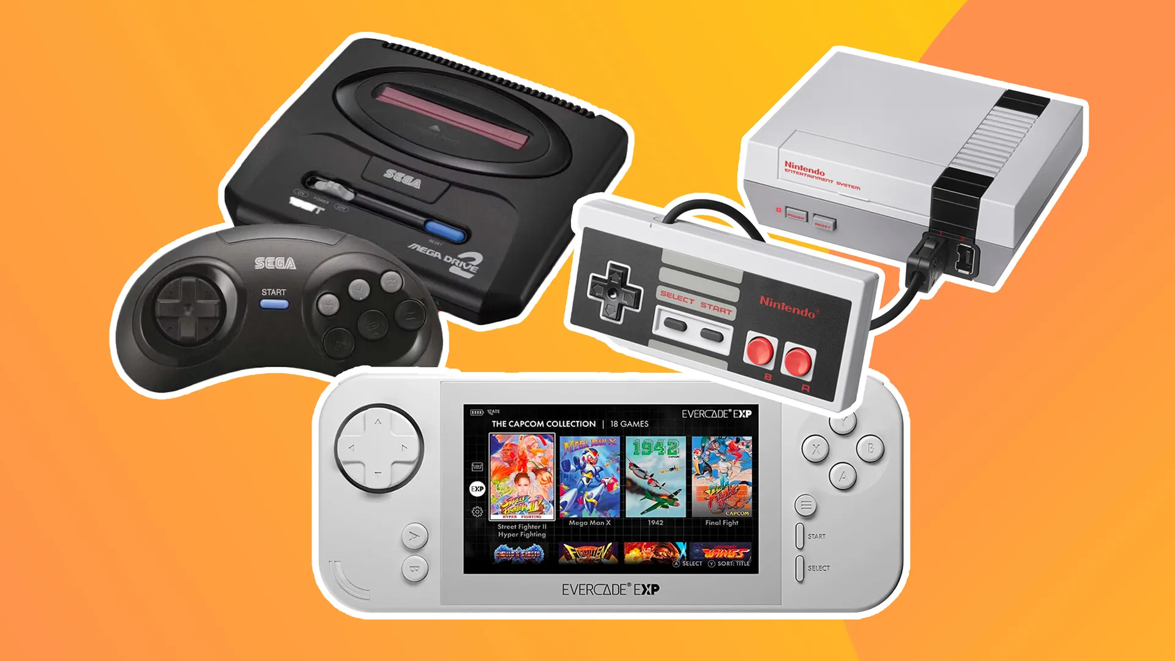
Application Types (5/8)
Entertainment systems
These are systems that are primarily for personal use and which are intended to entertain the user.
Examples: games.
https://www.creativebloq.com/buying-guides/best-retro-gaming-consoles
Notes:
may run on special-purpose console hardware.

Slide 40

Application Types (6/8)
Systems for modeling and simulation
These are systems that are developed by scientists and engineers to model physical processes or situations, which include many, separate, interacting objects.
Examples: MATLAB.
Notes:
MATLAB is a programming and numeric computing platform used by millions of engineers and scientists to analyze data, develop algorithms, and create models.

Slide 41
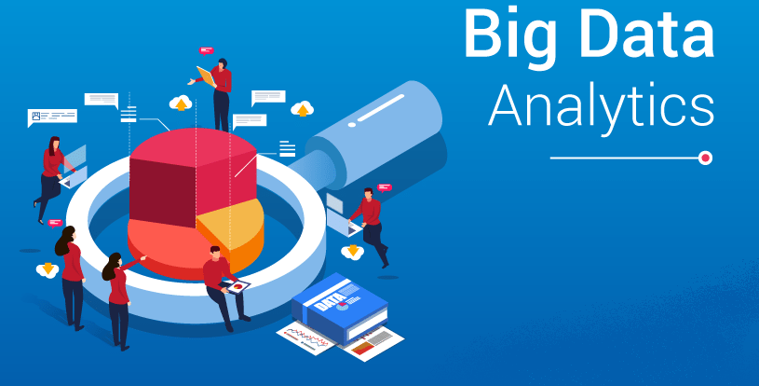
Application Types (7/8)
Data collection systems
System that collect data from their environment using a set of sensors and send that data to other systems for processing.
Examples: “Big data” analysis (may involve cloud-based systems) carrying out statistical analysis and looking for relationships in the collected data.
https://www.analyticsvidhya.com/blog/2023/02/top-20-big-data-tools-used-by-professionals-in-2023/

Slide 42
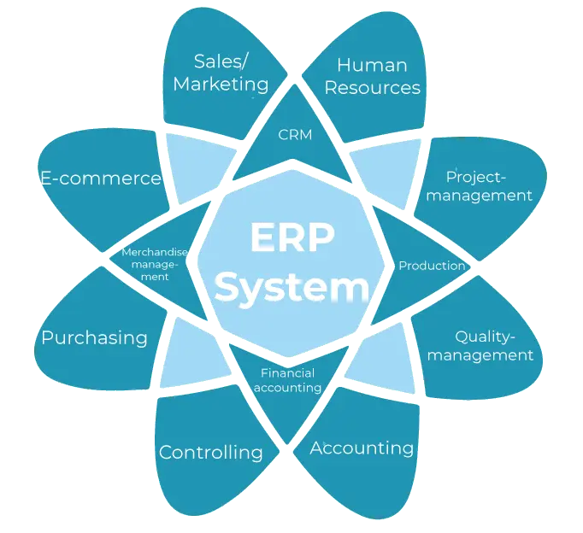
Application Types (8/8)
Systems of systems
Used in large organizations, and composed of a number of other software systems.
Examples: generic products such as Enterprise Resource Planning (ERP) systems.
https://www.weclapp.com/en/erp/
Notes:
Enterprise resource planning (ERP) refers to a type of software that organizations use to manage day-to-day business activities.
ERP such as systems from SAP and Oracle.

Slide 43
Software Engineering Fundamentals
Some fundamental principles apply to all types of software system, irrespective of the development techniques used:
Management: Systems should be developed using a managed and understood development process.
Dependability and performance: SW should behave as expected, without failure.
Requirements: Understanding and managing the software specification and requirements (what the software should do) are important.
Reuse: where appropriate, you should reuse software that has already been developed rather than write new software.

Slide 44
RECALL: FAQs
What are the attributes of good software?
2
3 Maintainable
2 Usable
1 Deliver the required functionality
(Efficient)
Attributes of
good software
4 Dependable and secure
Notes:
deliver the required functionality and performance to the user and should be maintainable, dependable
جدير بالثقه
and usable Efficient: high speed, high quality, low cost.

Slide 45
Software Engineering Fundamentals
Requirements
Reuse
Management
Software Engineering Fundamentals
Dependability

Slide 46
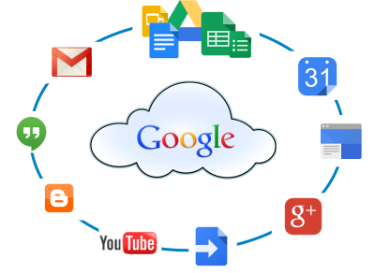
Internet Software Engineering
The Web is now a platform for running application and organizations are increasingly developing web-based systems rather than local systems.
Web services allow application functionality to be accessed over the web.
Cloud computing is an approach to the provision of computer services where applications run remotely on the ‘cloud’.
https://sites.google.com/a/york.ac.uk/google-apps-training/

Slide 47
RECALL: FAQs
10
What differences has the web made to software engineering?
The availability of software services (e.g., Google apps).
The possibility of developing highly distributed service-based systems.
Web-based systems development has led to important advances in programming languages and software reuse.
47

Slide 48
Web-based Software Engineering
Software reuse
dominant approach (using pre-existing software components).
Incremental and agile development
impractical to specify all the requirements in advance.
Service-oriented systems
stand-alone web services.
Rich interfaces
AJAX and HTML5.
Notes:
Ajax is a set of web development techniques that uses various web technologies on the client-side to create asynchronous web applications.
The HyperText Markup Language or HTML is the standard markup language for documents designed to be displayed in a web browser. It defines the meaning and structure of web content.

Slide 49

Do you have
any QUESTION?
Notes:
Do you have any Questions?

